Slide 1
Ratio
Taught by Yossef Ayman Zedan

Slide 2
Example
<div class="ratio ratio-16x9"> <iframe src="https://www.youtube.com/embed/zpOULjyy-n8?rel=0" title="YouTube video" allowfullscreen></iframe> </div>

Slide 3
Aspect ratios
Aspect ratios can be customized with modifier classes. By default the following ratio classes are provided:
<div class="ratio ratio-1x1"> <div>1x1</div> </div> <div class="ratio ratio-4x3"> <div>4x3</div> </div> <div class="ratio ratio-16x9"> <div>16x9</div> </div> <div class="ratio ratio-21x9"> <div>21x9</div> </div>

Slide 4
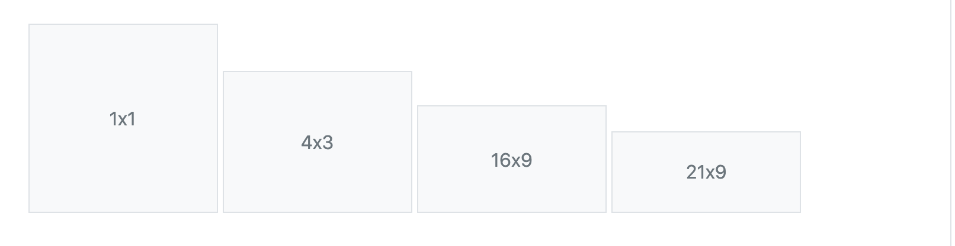
Aspect ratios

Slide 5
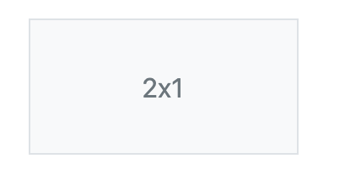
Custom ratios
Each .ratio-* class includes a CSS custom property (or CSS variable) in the selector. You can override this CSS variable to create custom aspect ratios on the fly with some quick math on your part.
For example, to create a 2x1 aspect ratio, set --bs-aspect-ratio: 50% on the .ratio
<div class="ratio" style="--bs-aspect-ratio: 50%;"> <div>2x1</div> </div>

Slide 6
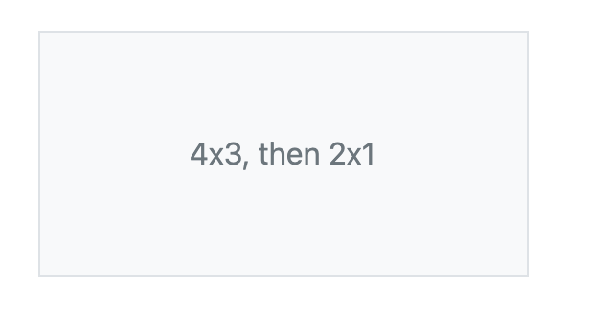
CSS variable
This CSS variable makes it easy to modify the aspect ratio across breakpoints. The following is 4x3 to start, but changes to a custom 2x1 at the medium breakpoint.
.ratio-4x3 { @include media-breakpoint-up(md) { --bs-aspect-ratio: 50%; // 2x1 } }
HTML:
<div class="ratio ratio-4x3"> <div>4x3, then 2x1</div> </div>

